Slide 1

Target Markets for a Business

Slide 2

Assignment
In your activity Packet Answer in your own words why do you think that Market Segmentation to find your Target Market is important to businesses?
Google Classroom Assignment

Slide 3
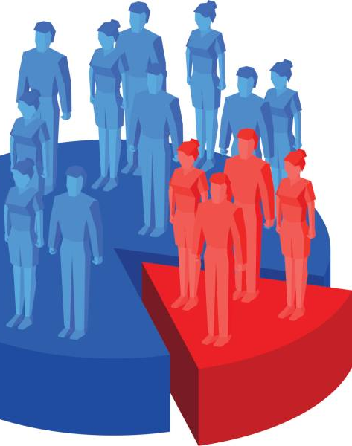
Reminder:
Market: All the people who buy products
Market segmentation: when you narrow the whole market down through common buying characteristics to focus on specific pieces of the market
When you Identify the smaller pieces, you focus your Marketing Efforts towards:
Product - How you will design and create product
Place – Where you will sell it
Price – what you will sell it for
Promotion - where and how you tell customers about it

Slide 4
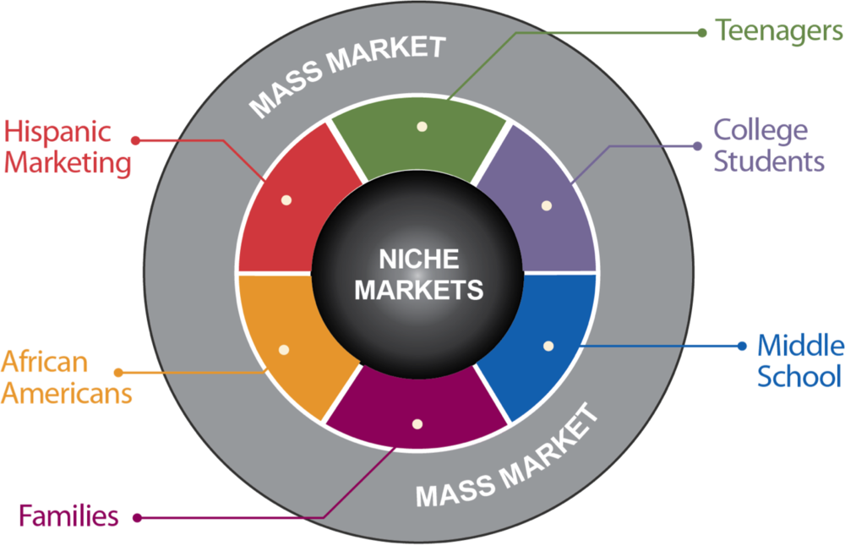
Three Ways to Market Products
mass market = target everyone in the world
target market = smaller pieces, 2 or more, of the mass market with common buying characteristics
Niche market = 1 very specific piece of the market

Slide 5

How to do Market Segmentation (Narrow)
There are many ways to NARROW OR SEGMENT the mass market.
We will focus on the most common ways:
What do you think are the most common characteristics to NARROW down to your Target Market?
Think about our Walking Devices?
Your Answers:

Slide 6
Market Segmentation
Most common characteristics Segment (NARROW) to your Target
Age: age range
Gender: male, female or both
Income level: low, middle or high
Geographic residence: country, climate, urban, rural
Marital Status: single, married
Education: high school, college, graduate
Occupation: Any, professional, or specific
Lifestyle/Interests/Hobbies: likes, values, interests
Why they Buy it: save money, time, status, for fun

Slide 7

Snowmobile Example:
Age:
Gender:
Income level:
Geographic residence:
Marital Status:
Education:
Occupation:
Lifestyle/Interests/Hobbies:
Why they Buy it:
Person(s) most likely to buy my product

Slide 8
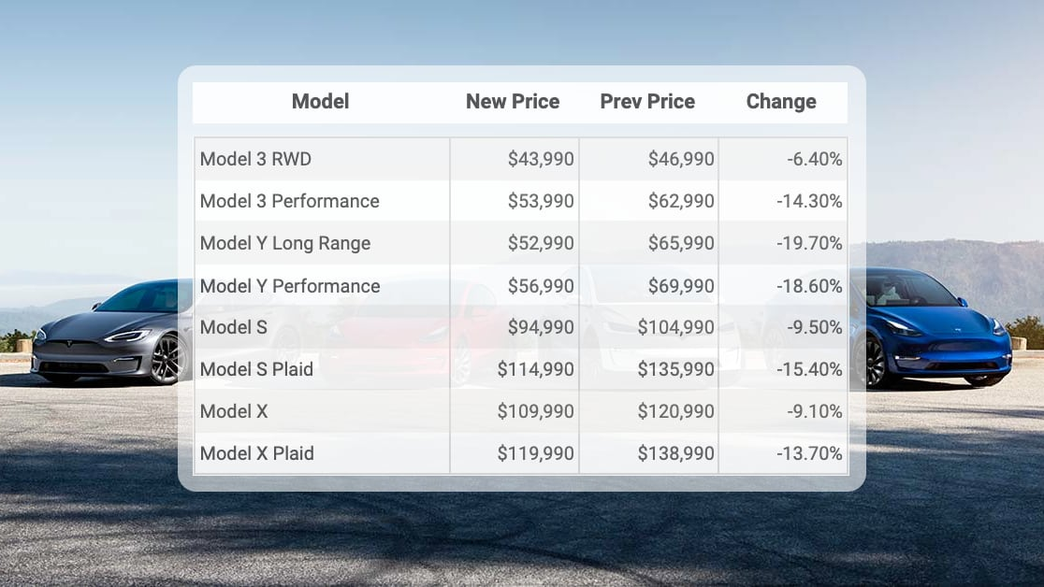
Tesla Assignment
Age:
Gender:
Income level:
Geographic residence:
Marital Status:
Education:
Occupation:
Lifestyle/Interests/Hobbies:
Why they Buy it:

Slide 9

Answers to the Tesla Assignment

Slide 10

Why Define a Target Market?
Benefits to Defining a target market:
Helps businesses:
Enhanced Focus and Efficiency: Allocate their Marketing budget, time, and resources more efficiently (saving money and time)
Better Product Development: Focus on the wants and needs of that type of customer
Better Financial Performance: Higher ROI (return on investment): Focused marketing efforts typically result in higher returns on investment
Cost Efficiency: By targeting a specific market, businesses can reduce wasteful spending on broad, ineffective marketing campaigns

Slide 11

Team Activity: Niche Target Market
Directions: With your team, select one of the niche markets that are popular right now. Next, create an idea for a new product for that market. Then, define the target market for your assigned product using the characteristics discussed. Be prepared to share your product and target market characteristics with the class, highlighting the reasoning behind their choices.

Slide 12

Quick Write!
Think about a luxury car brand. What characteristics might define their target market? How might this differ from the broader segment of people interested in cars?

